Slide 1
Come in Quietly
Concept
Take out a pen or pencil and a piece of binder paper.

Slide 2
Objective: Enumerate the Powers and Requirements of the President.
Objective
Standard 8.2.6: Enumerate the powers of government set forth in the Constitution and the fundamental liberties ensured by the Bill of Rights.
WH 8.4: Produce clear and coherent writing in which the development, organization, and style are appropriate to task, purpose, and audience.

Slide 3
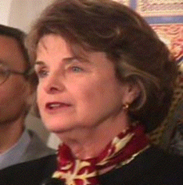
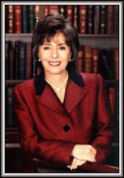

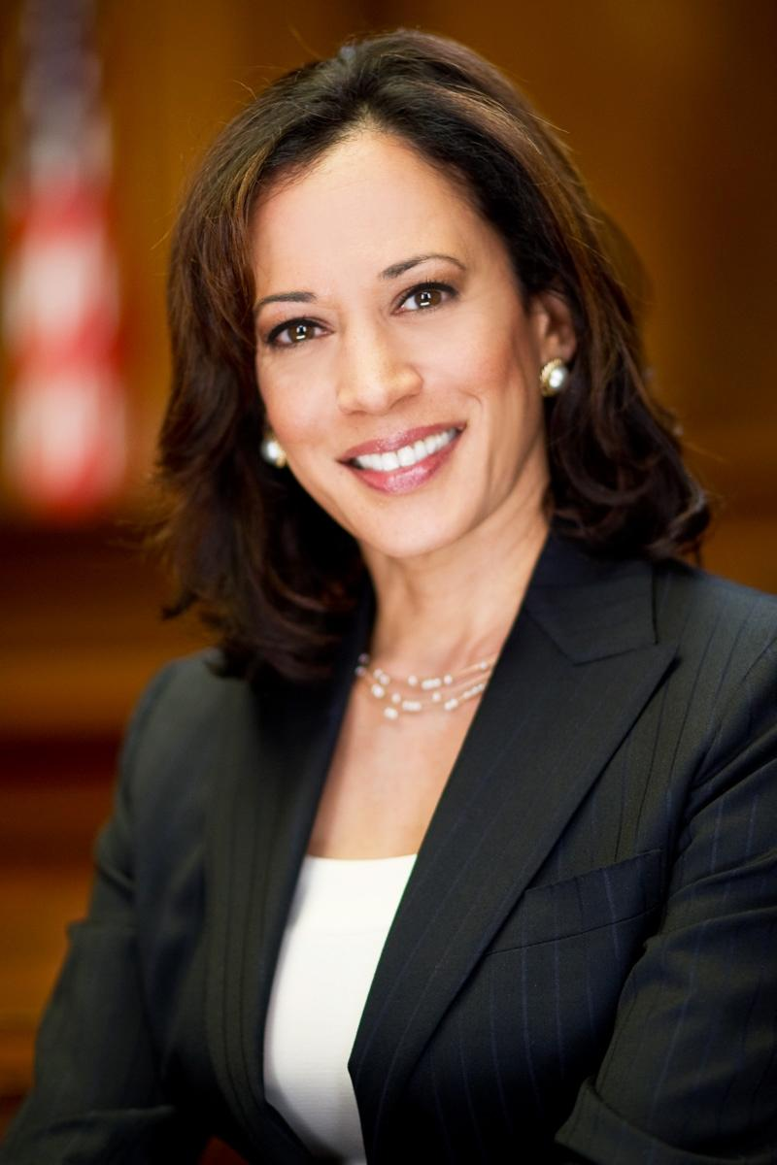

Concept
Why did the Constitution split the Legislative Branch into two parts?
The Senate
Senator-Elect Kamala Harris
The Senate is the other part of Congress.
There are two senators for each state, which means there are 100 Senators.
Senators must be at least 30 years old.
Senators must be a citizen for at least 9 years.
Senators must live in the state they are representing.
Senators are elected to a six year term.

Slide 4
Closure
What are the top 3 powers of the Legislative Branch?
What are the names of the two houses in Congress?
How many years does a Senator serve?
How many years does a Representative serve?

Slide 5

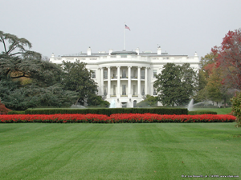
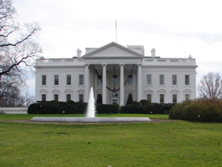
Concept
The Executive Branch
Article 2
The Executive branch is also called the President.
The Enumerated Powers of the President are:
Take care that the laws be faithfully executed
Recommend Legislation
Commander in Chief of the Armed Forces
Grant reprieves and pardons
Make treaties
Nominate and Appoint Ambassadors and Supreme Court Justices
Give Congress information on the State of the Union
Receive Ambassadors and other Public Ministers
What powers did the Constitution give the President?

Slide 6
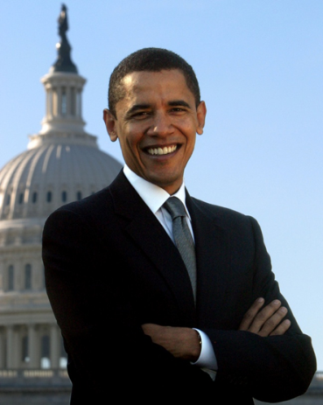
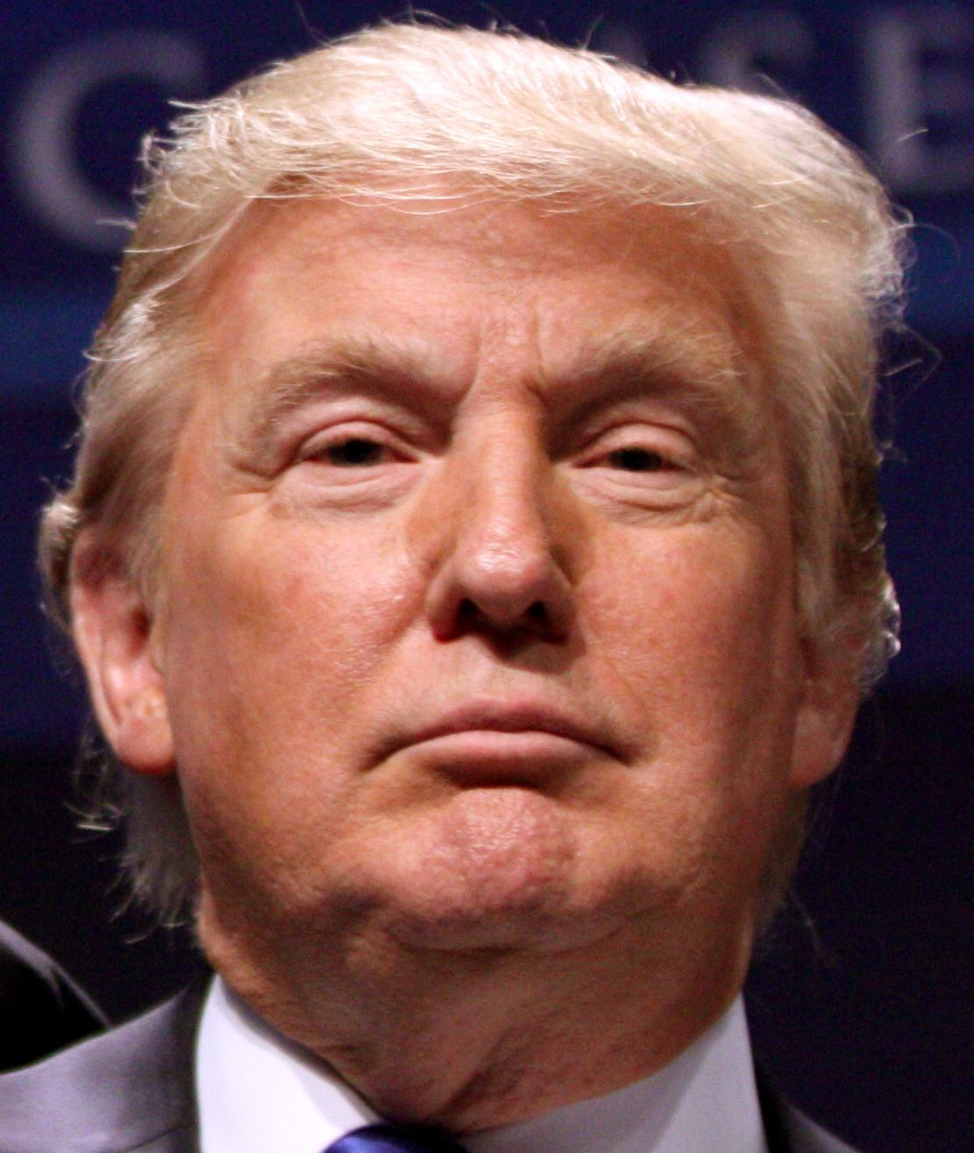
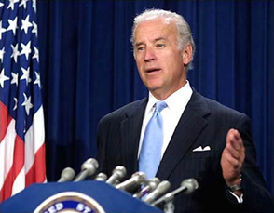
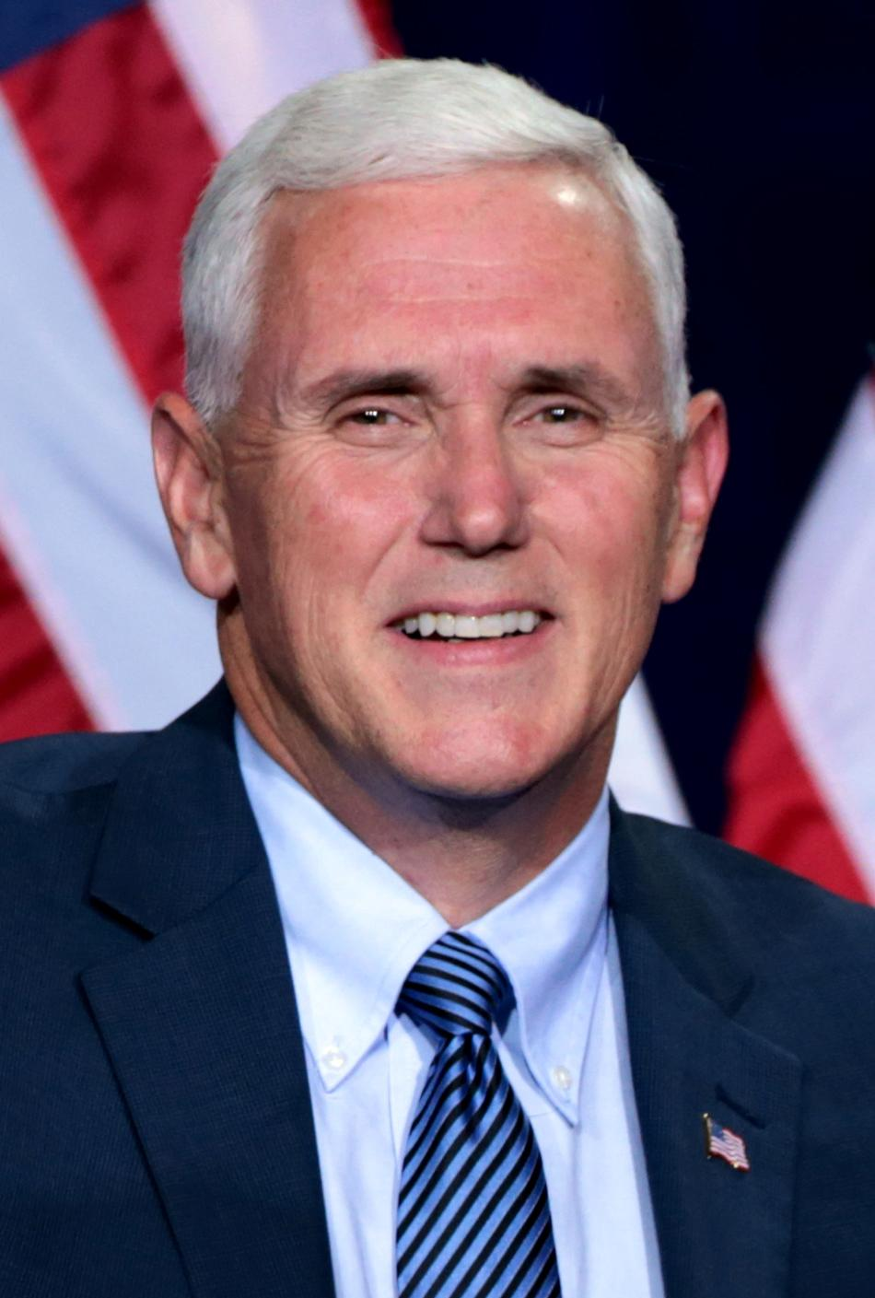
The President today is Barack Obama
Concept
The President
The President is elected to a four-year term.
The President can only serve two terms (8 years).
The President must be a citizen by birth.
The President must be at least 35 years old.
The President must have lived in the United States at least 14 years.
Why does the Constitution requires the President to be a citizen by birth?
The President-Elect is Donald Trump
The Vice-President - Elect is Mike Pence.

Slide 7
Quick Write
Closure
Write a paragraph.
Explain the powers given to the President by the Constitution and which you think is the most important and why.

